Slide 1

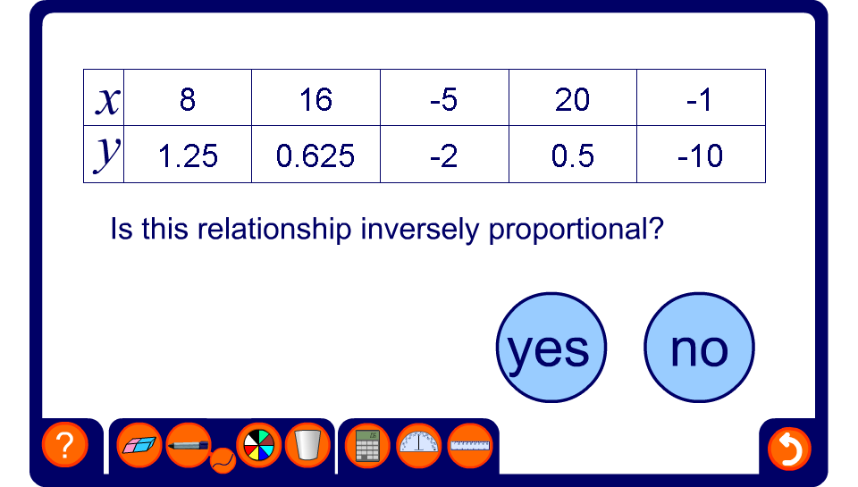


Checking for inverse proportionality
Notes:
By finding the constant of proportionality or otherwise, ask pupils to determine whether the number in the table are inversely proportional.
Pupils should notice that they can check this quickly by multiplying the variables together to get to constant value.
If the values in the table are inversely proportional ask pupils to write an equation to link them.

